Slide 1
Machine Learning With Python
By Madhup Pandey
Email: madhupsgr@gmail.com

Slide 2
Agenda
Bagging and Boosting
Support Vector Machine
K-NN

Slide 3
Support Vector Machine??
“Support Vector Machine” (SVM) is a supervised machine learning algorithm which can be used for both classification or regression challenges.
However, it is mostly used in classification problems. In this algorithm, we plot each data item as a point in n-dimensional space (where n is number of features you have) with the value of each feature being the value of a particular coordinate.
Then, we perform classification by finding the hyper-plane that differentiate the two classes very well.

Slide 4
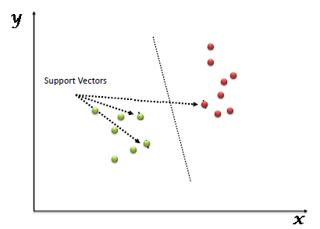
Support Vectors
Support Vectors are simply the co-ordinates of individual observation. Support Vector Machine is a frontier which best segregates the two classes (hyper-plane/ line).

Slide 5
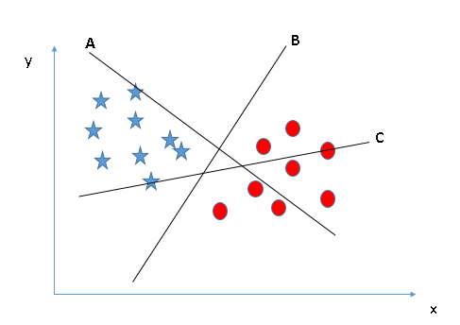
Identify the right hyper-plane (Scenario-1):

Slide 6
How does it work?
Here, we have three hyper-planes (A, B and C). Now, identify the right hyper-plane to classify star and circle.
You need to remember a thumb rule to identify the right hyper-plane: “Select the hyper-plane which segregates the two classes better”. In this scenario, hyper-plane “B” has excellently performed this job.

Slide 7
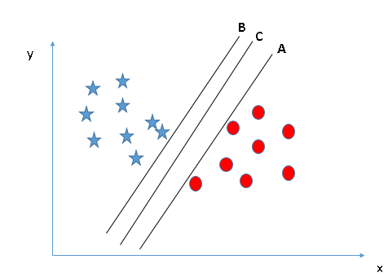
Identify the right hyper-plane (Scenario-2):

Slide 8
Identify the right hyper-plane
Here, we have three hyper-planes (A, B and C) and all are segregating the classes well. Now, How can we identify the right hyper-plane?
Here, maximizing the distances between nearest data point (either class) and hyper-plane will help us to decide the right hyper-plane. This distance is called as Margin.

Slide 9
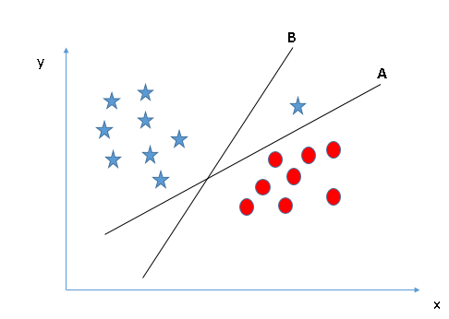

Slide 10
Identify the right hyper-plane
Hint: Use the rules as discussed in previous section to identify the right hyper-plane
Some of you may have selected the hyper-plane B as it has higher margin compared to A.
But, here is the catch, SVM selects the hyper-plane which classifies the classes accurately prior to maximizing margin.
Here, hyper-plane B has a classification error and A has classified all correctly. Therefore, the right hyper-plane is A.

Slide 11
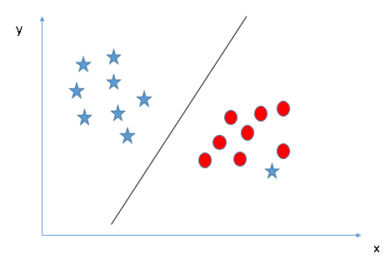
Identify the two classes

Slide 12
Can we classify two classes
I am unable to segregate the two classes using a straight line, as one of star lies in the territory of other(circle) class as an outlier.
As I have already mentioned, one star at other end is like an outlier for star class.
SVM has a feature to ignore outliers and find the hyper-plane that has maximum margin. Hence, we can say, SVM is robust to outliers.

Slide 13
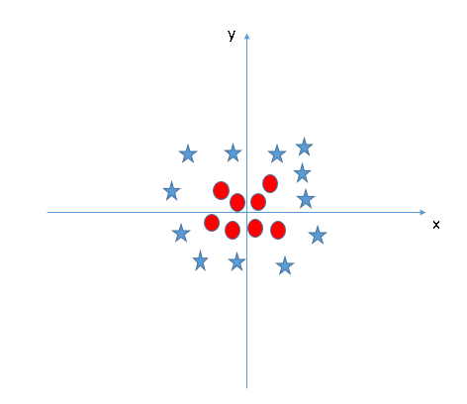
How we can classify???

Slide 14
Find the hyper-plane to segregate to classes
We can’t have linear hyper-plane between the two classes, so how does SVM classify these two classes?
Till now, we have only looked at the linear hyper-plane.

Slide 15
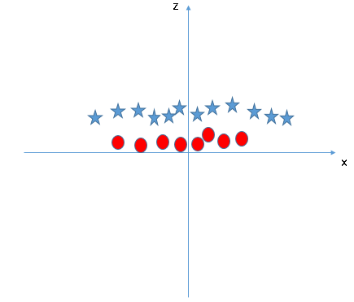
SVM can solve this problem. Easily! It solves this problem by introducing additional feature.
Here, we will add a new feature z=x^2+y^2. Now, let’s plot the data points on axis x and z:

Slide 16
SVM
In above plot, points to consider are:
All values for z would be positive always because z is the squared sum of both x and y
In the original plot, red circles appear close to the origin of x and y axes, leading to lower value of z and star relatively away from the origin result to higher value of z.

Slide 17
SVM
In SVM, it is easy to have a linear hyper-plane between these two classes. But, another burning question which arises is, should we need to add this feature manually to have a hyper-plane.
No, SVM has a technique called the kernel trick.
These are functions which takes low dimensional input space and transform it to a higher dimensional space i.e. it converts not separable problem to separable problem, these functions are called kernels.
It is mostly useful in non-linear separation problem. Simply put, it does some extremely complex data transformations, then find out the process to separate the data based on the labels or outputs you’ve defined.

Slide 18
How to implement SVM in Python?
In Python, scikit-learn is a widely used library for implementing machine learning algorithms, SVM is also available in scikit-learn library and follow the same structure (Import library, object creation, fitting model and prediction).

Slide 19
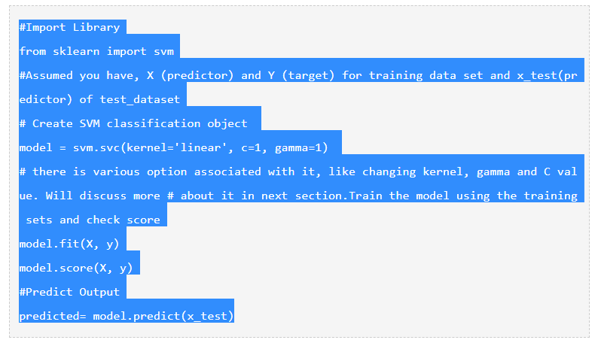

Slide 20
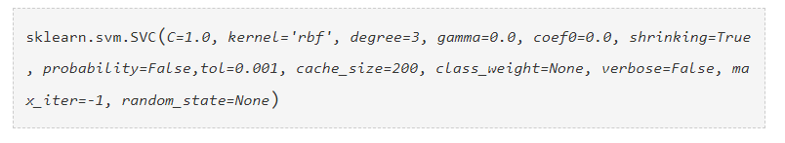
How to tune Parameters of SVM?
Tuning parameters value for machine learning algorithms effectively improves the model performance.
Let’s look at the list of parameters available with SVM.
Some important parameters having higher impact on model performance, “kernel”, “gamma” and “C”.

Slide 21
Kernel
Here, we have various options available with kernel like, “linear”, “rbf”,”poly” and others (default value is “rbf”).
Here “rbf” and “poly” are useful for non-linear hyper-plane.

Slide 22
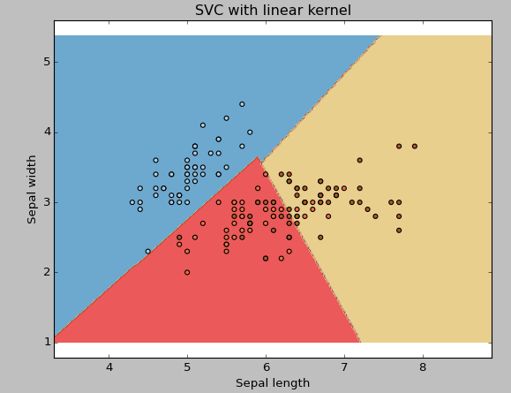

Slide 23
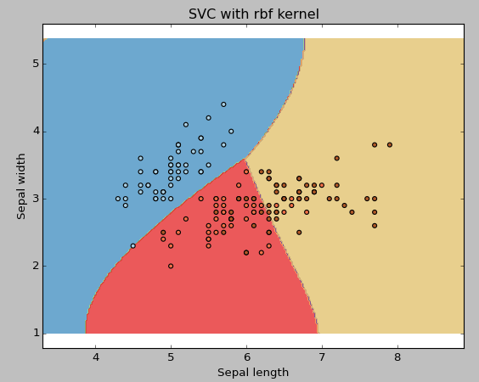

Slide 24
It would be suggested to go for linear kernel if we have large number of features (>1000) because it is more likely that the data is linearly separable in high dimensional space. Also, we can use RBF but we have to take care of accuracy and overfitting.
gamma: Kernel coefficient for ‘rbf’, ‘poly’ and ‘sigmoid’. Higher the value of gamma, will try to exact fit the as per training data set i.e. generalization error and cause over-fitting problem.

Slide 25
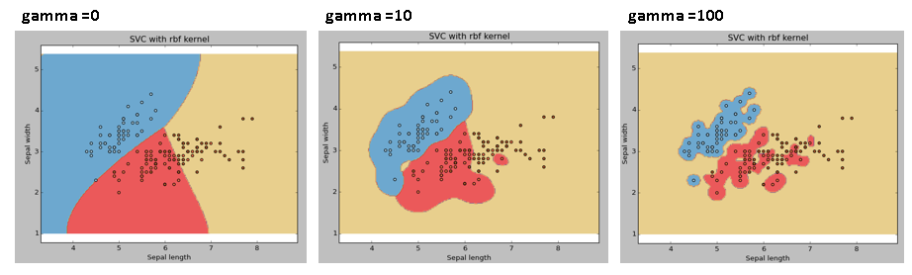
Example:
Let’s difference if we have gamma different gamma values like 0, 10 or 100.

Slide 26
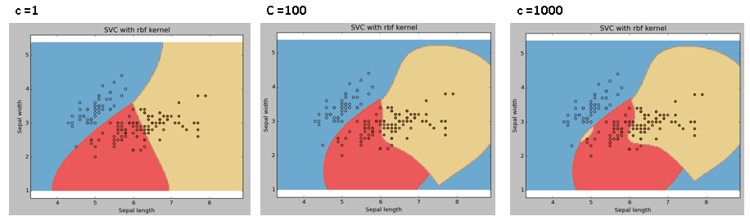
C: Penalty parameter C of the error term. It also controls the trade off between smooth decision boundary and classifying the training points correctly.
We should always look at the cross validation score to have effective combination of these parameters and avoid over-fitting.

Slide 27
Pros and Cons associated with SVM
Pros:
It works really well with clear margin of separation
It is effective in high dimensional spaces.
It is effective in cases where number of dimensions is greater than the number of samples.
It uses a subset of training points in the decision function (called support vectors), so it is also memory efficient.

Slide 28
Corns
Cons:
It doesn’t perform well, when we have large data set because the required training time is higher
It also doesn’t perform very well, when the data set has more noise i.e. target classes are overlapping

Slide 29
Bagging
The idea behind bagging is combining the results of multiple models (for instance, all decision trees) to get a generalized result.
Here’s a question: If you create all the models on the same set of data and combine it, will it be useful?
There is a high chance that these models will give the same result since they are getting the same input. So how can we solve this problem? One of the techniques is bootstrapping.

Slide 30
Bootstrapping
Bootstrapping is a sampling technique in which we create subsets of observations from the original dataset, with replacement.
The size of the subsets is the same as the size of the original set.

Slide 31
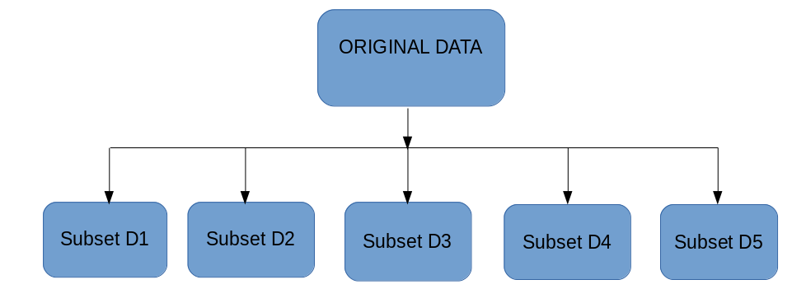
Bagging
Bagging (or Bootstrap Aggregating) technique uses these subsets (bags) to get a fair idea of the distribution (complete set).
The size of subsets created for bagging may be less than the original set.

Slide 32
Bagging
Multiple subsets are created from the original dataset, selecting observations with replacement.
A base model (weak model) is created on each of these subsets.
The models run in parallel and are independent of each other.
The final predictions are determined by combining the predictions from all the models.

Slide 33
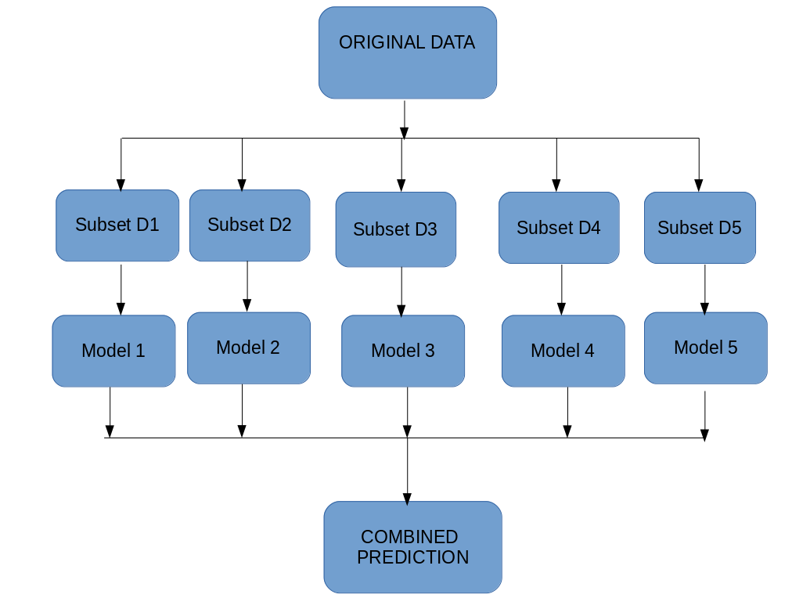

Slide 34
Boosting
If a data point is incorrectly predicted by the first model, and then the next (probably all models), will combining the predictions provide better results?
Such situations are taken care of by boosting.
Boosting is a sequential process, where each subsequent model attempts to correct the errors of the previous model.
The succeeding models are dependent on the previous model.

Slide 35
How boosting works???
Let’s understand the way boosting works in the below steps.
A subset is created from the original dataset.
Initially, all data points are given equal weights.
A base model is created on this subset.
This model is used to make predictions on the whole dataset.
Errors are calculated using the actual values and predicted values.
The observations which are incorrectly predicted, are given higher weights.
Another model is created and predictions are made on the dataset. (This model tries to correct the errors from the previous model)
Similarly, multiple models are created, each correcting the errors of the previous model.
The final model (strong learner) is the weighted mean of all the models (weak learners).

Slide 36
Boosting Algorithm
Thus, the boosting algorithm combines a number of weak learners to form a strong learner.
The individual models would not perform well on the entire dataset, but they work well for some part of the dataset.
Thus, each model actually boosts the performance of the ensemble.

Slide 37
AdaBoost
Adaptive boosting or AdaBoost is one of the simplest boosting algorithms.
Usually, decision trees are used for modelling.
Multiple sequential models are created, each correcting the errors from the last model.
AdaBoost assigns weights to the observations which are incorrectly predicted and the subsequent model works to predict these values correctly.

Slide 38
AdaBoost
We take the training data and randomly sample points from this data and apply classification algorithm to classify the points.
After classifying the sampled points we fit the classification algorithm to the complete training data.
This process iteratively happens until the complete training data fits without any error or until a specified maximum number of estimators.
After sampling from training data and applying the classification algorithm the model fits as showcased below.

Slide 39
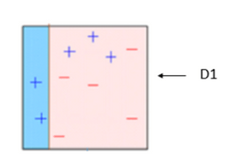
AdaBoost- Example

Slide 40
AdaBoost- Example
We can observe that three of the positive samples are misclassified as negative.
Therefore, we exaggerate the weights of these misclassified samples so that that they have a better chance of being selected when sampled again.

Slide 41
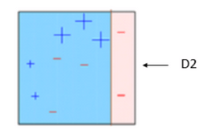
AdaBoost- Example
When data is sampled next time, the d2 is combined with d1 to fit the training data.
Therefore we have a miniature ensemble here trying to fit the data perfectly.
This miniature ensemble of two decisions misclassifies three negative samples as positive.
Therefore, we exaggerate the weights of these misclassified samples so that that they have a better chance of being selected when sampled again.

Slide 42
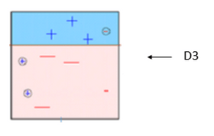
AdaBoost- Example
The previously misclassified samples are chosen and d3 is applied to fit the training data.
We can find that two positive samples are classified as negative and one negative sample is classified as positive.
Then the ensemble of three d(1, 2 and 3) are used to fit the complete training data.
When this ensemble of three decisions are used the model fits the training data perfectly.

Slide 43
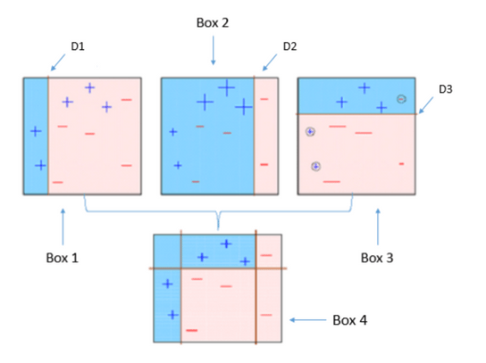
AdaBoost- Example

Slide 44
Drawback of AdaBoost
The drawback of AdaBoost is that it is easily defeated by noisy data, the efficiency of the algorithm is highly affected by outliers as the algorithm tries to fit every point perfectly.
You might be wondering since the algorithm tries to fit every point, doesn’t it overfit?
No, it does not.
The answer has been found out through experimental results, there has been speculations but no concrete reasoning available.

Slide 45
Gradient Boosting (GBM)
Gradient Boosting or GBM is another ensemble machine learning algorithm that works for both regression and classification problems.
GBM uses the boosting technique, combining a number of weak learners to form a strong learner.
Regression trees used as a base learner, each subsequent tree in series is built on the errors calculated by the previous tree.
This is algorithm is similar to Adaptive Boosting(AdaBoost) but differs from it on certain aspects.
In this method we try to visualize the boosting problem as an optimization problem, i.e we take up a loss function and try to optimize it.

Slide 46
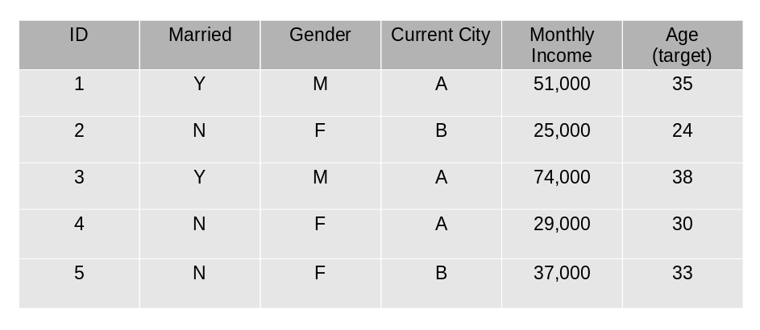
Example
We will use a simple example to understand the GBM algorithm.
We have to predict the age of a group of people using the below data:

Slide 47
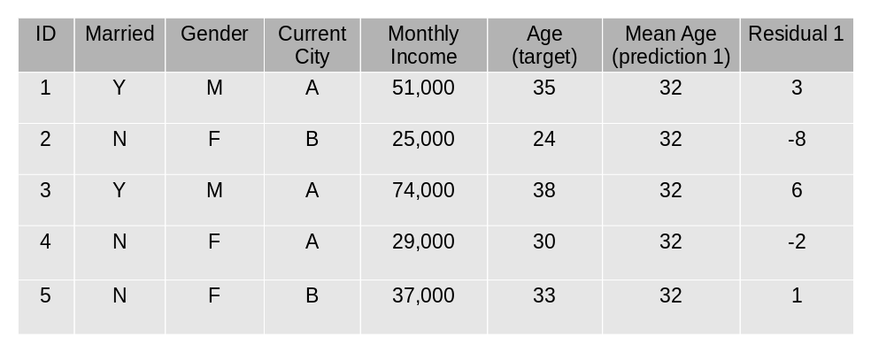
Steps for GBM
The mean age is assumed to be the predicted value for all observations in the dataset.
The errors are calculated using this mean prediction and actual values of age.

Slide 48
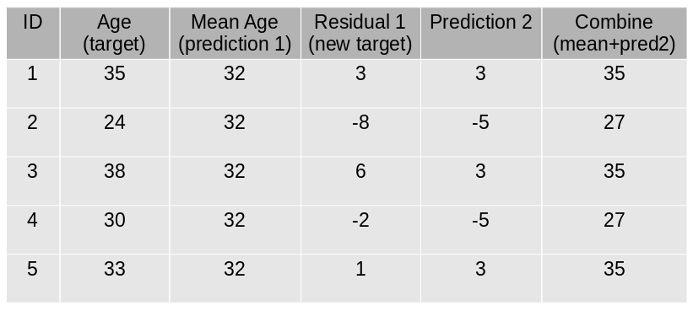
Steps of GBM
3. A tree model is created using the errors calculated above as target variable. Our objective is to find the best split to minimize the error.
4. The predictions by this model are combined with the predictions 1.

Slide 49
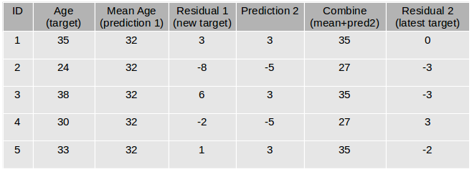
Steps of GBM
5. This value calculated above is the new prediction.
6. New errors are calculated using this predicted value and actual value.
7. Steps 2 to 6 are repeated till the maximum number of iterations is reached (or error function does not change).

Slide 50
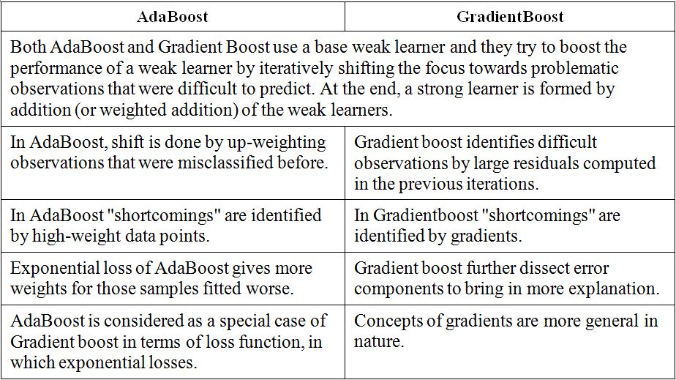

Slide 51
XG-Boost
XG-Boost (extreme Gradient Boosting) is an advanced implementation of the gradient boosting algorithm.
XG-Boost has proved to be a highly effective ML algorithm, extensively used in machine learning.
XG-Boost has high predictive power and is almost 10 times faster than the other gradient boosting techniques. It also includes a variety of regularization which reduces over-fitting and improves overall performance.
Hence it is also known as ‘regularized boosting‘ technique.

Slide 52


